Slide 1
Distant Reading of Late-nineteenth and Early-twentieth Century British Adventure Fiction
R.M. Ballantyne (1825-1894)
G.A. Henty (1832-1902)
W.H.G. Kingston (1814-1880)
H. Rider Haggard (1856-1925)

Slide 2
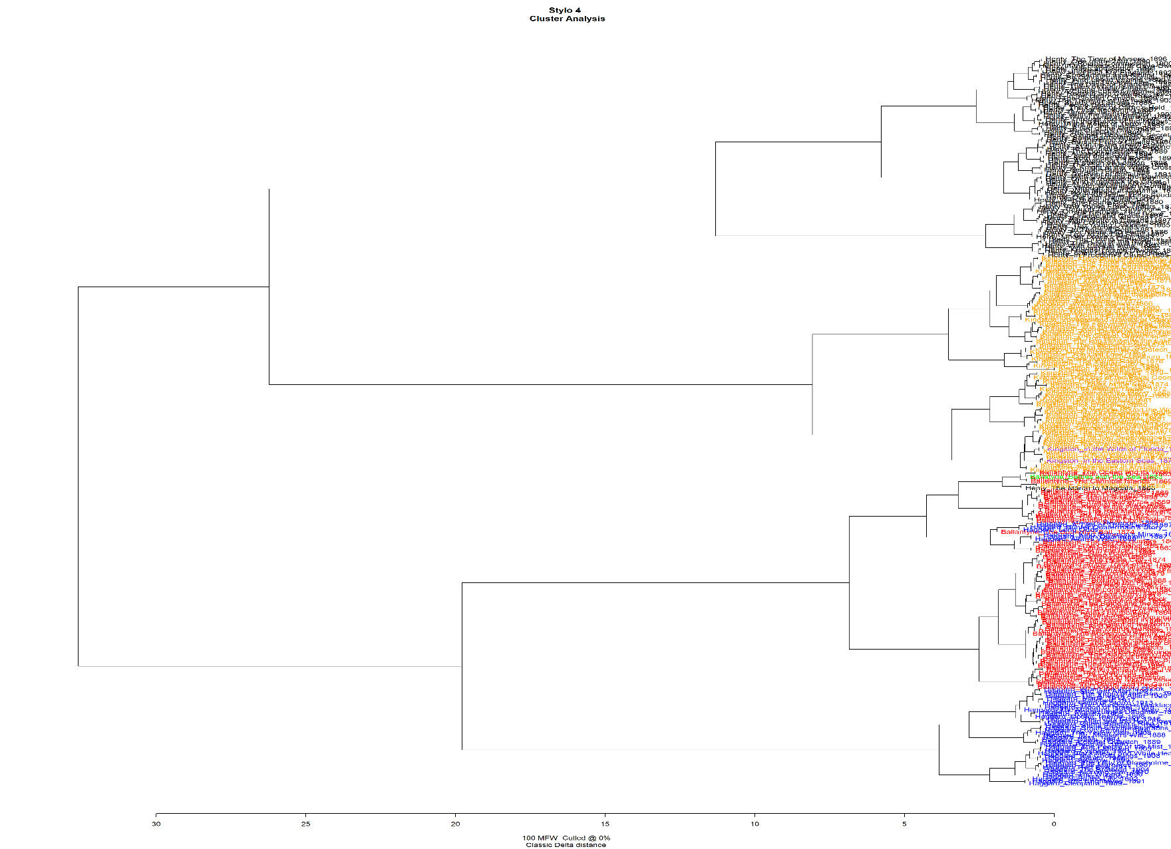
Stylo Dendrogram

Slide 3
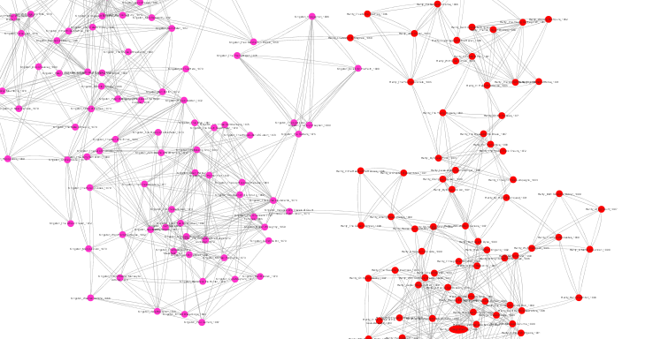
Kingston and Henty

Slide 4
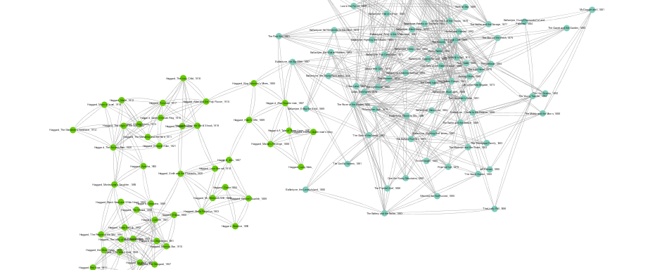
Haggard and Ballantyne

Slide 5
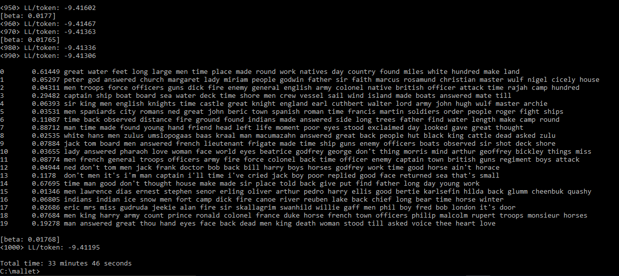
Topic Modeling

Slide 6
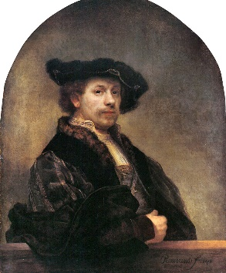
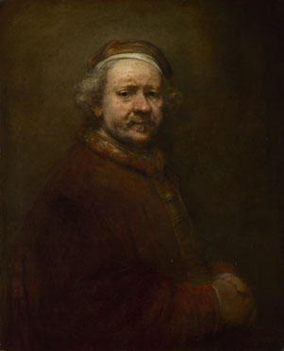
Rembrandt (1606-1669)
1640
1669

Slide 7
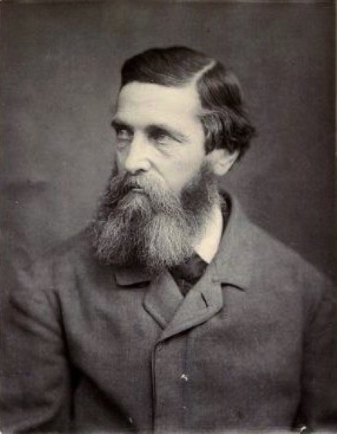
R.M. Ballantyne (1825-1894)
2 Corpus:
1857-1874
1875-1895

Slide 8
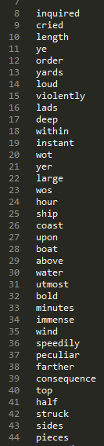
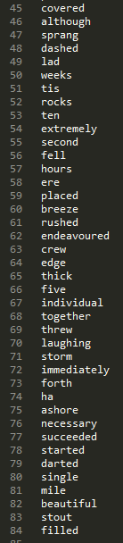
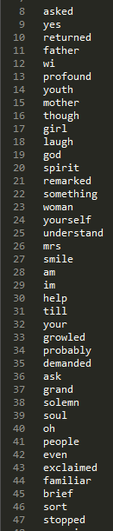
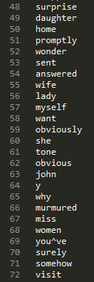
1857-1874
1875-1895

Slide 9
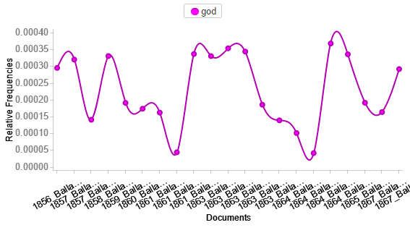
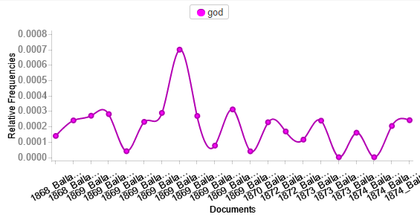
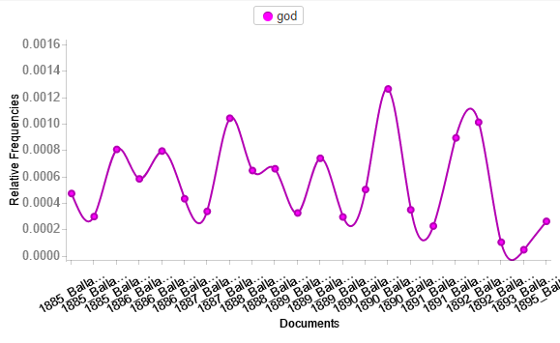
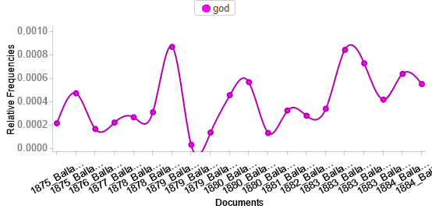
Use of “God”
1857-1867
1868-1874
1875-1884
1885-1895

Slide 10
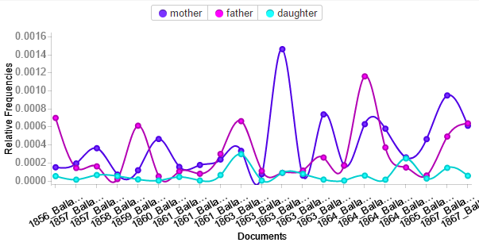
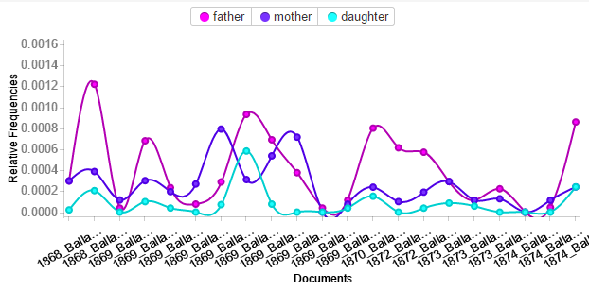
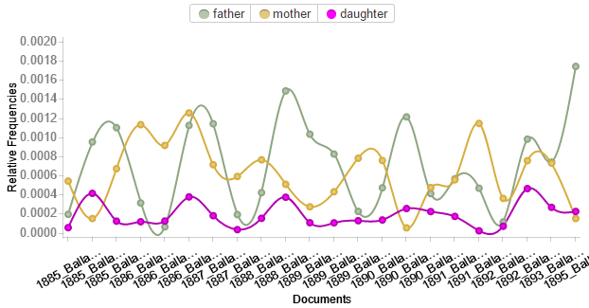
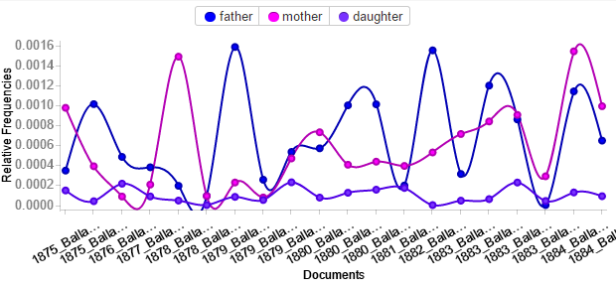
Use of familial terms
1857-1867
1868-1874
1875-1884
1885-1895

Slide 11
Hypothesis:
R.M. Ballantyne increased his usage of religious and familial language in the later years of his career and this suggests that the themes of his stories may have changed as well.

